Slide 1

What’s New in VA Benefits
Sioux Falls Veterans Benefits Administration
Megan Carter, Acting Veterans Service Center Manager
Notes:
AS DUCKWORTH

Slide 2
agenda
Automated Decisions
VA Form 20-0995, Supplemental Claims
Voided Checks
Inferred Issues
Character of Discharge

Slide 3
Automated Decision Support (ADS)
Why is VBA using Automated Decision Support?
ADS drives consistency and equity in initial review by applying standardized logic.
It can reduce overdevelopment by identifying evidence of record efficiently.
In some cases, it allows a Veteran to receive a partial rating decision without having to wait for every contention to be developed

Slide 4
ADS Continued
What does ADS do?
Automates time-consuming manual tasks
Retrieve and consolidate medical records, providing a summary document that indexes information pertinent for making decisions and/or draft or order necessary medical exams

Slide 5
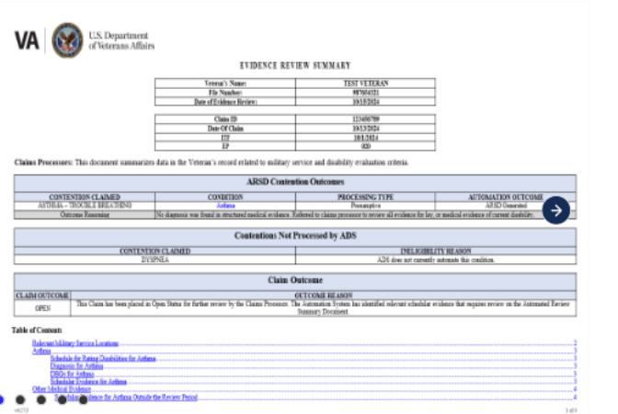
Automated review summary document (ARSD)
The Automated Review Summary Document, or ARSD, indexes all medical and service history records into a summary

Slide 6
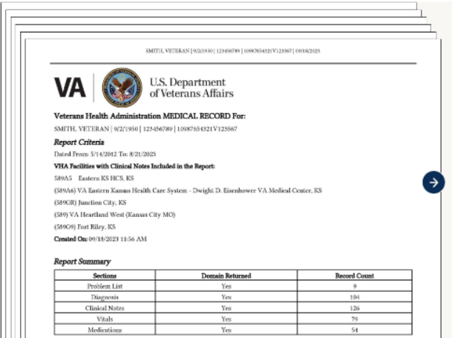
Health data repository (HDR) Document
The Health Data Repository Document (HDR) compiles thousands of medical records across VA Medical Center facilities into a standardized, searchable document

Slide 7
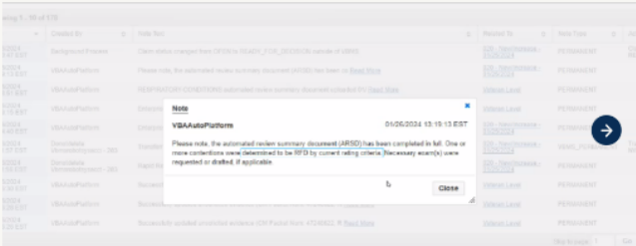
Evidence evaluation capability
The Evidence Evaluation Capability assess if evidence is present that may allow for a rating decision, or if an exam should be ordered for expert medical review

Slide 8
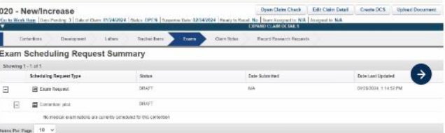
Exam drafting and ordering capability
In some cases, ADS drafts or orders an exam via the Exam Management Service (EMS).

Slide 9
Inferred Issues
DEA under 38 U.S.C. Chapter 35
SAH under 38 CFR 3.809
special home adaptation (SHA) grants under 38 CFR 3.809a
automobile and adaptive equipment under 38 CFR 3.808
vocational rehabilitation/employment, and
loan guaranty for surviving spouses under 38 CFR 3.805.
A claim for hearing loss and tinnitus is diagnosed
A claim for either sinusitis or allergic rhinitis

Slide 10
VA Form 20-0995, Supplemental Claims
Supplemental claims require new and relevant evidence in order for the claim to be readjudicated.
As defined in 38 CFR 3.2501, new evidence is evidence not previously part of the actual record before agency adjudicators. Relevant evidence is information that tends to prove or disprove a matter at issue in a claim. Relevant evidence includes evidence that raises a theory of entitlement that was not previously addressed.
Note: New evidence that affirms findings previously deemed favorable to the claimant is still relevant. There is no requirement that relevant evidence prove a previously unsubstantiated matter.

Slide 11
Supplemental Claim Continued
Example: A Veteran was previously denied service connection (SC) for a low back condition. Evidence at the time of the prior decision noted a back strain on active duty in 1980. Post-service medical records showed degenerative changes in the lumbar spine beginning in 2015. The claim was denied as not incurred in service based on a medical opinion that the current lumbar spine disability was not due to the strain in service. On August 19, 2019, the Veteran filed a supplemental claim for the low back condition. VA medical center treatment records showed ongoing complaints of low back pain.
Result: The supplemental claim is considered substantially complete based on new treatment records. The claim also warrants a merits-based decision since the treatment records, despite relating only to a previously established fact, are relevant to the claim for the back condition.

Slide 12
Supplemental Claims Continued
In some cases, a Veteran may submit a private positive medical opinion with a supplemental claim for SC for a condition that was previously denied due to no nexus to service. The decision maker must review the medical opinion to ensure it contains a supporting rationale and is adequate for rating purposes. If the evidence is adequate for rating purposes, weigh the evidence and make a decision. Follow the guidelines specified in M21-1, Part IV, Subpart i, 3.C.1.c and d when determining if clarification or reconciliation by an examiner is needed or if a new examination is needed to resolve inconsistencies.

Slide 13
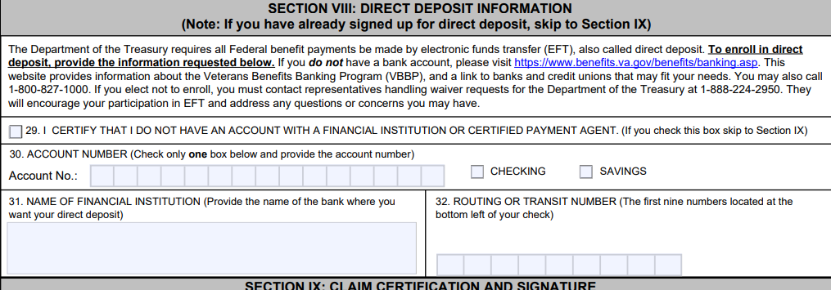
Voided Checks and va form 21-526EZ
If the VA Form 21-526EZ does not state that you need a voided check and you receive a letter, disregard the letter.

Slide 14
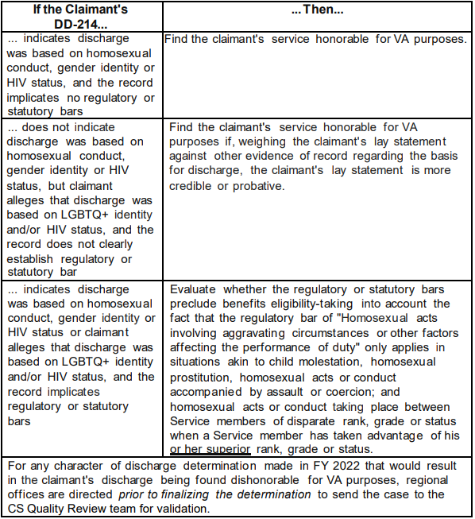
Character of Discharges (COD)

Slide 15

Thank You!

